Slide 1


Real-time teleophthalmology in rural Western Australia: a service evaluation
Johnson KA, Meyer JY & Turner AW

Slide 2
The service…
This map is adapted from Telehealth Eligible Service Areas available from: http://www.mbsonline.gov.au/internet/mbsonline/publishing.nsf/content/connectinghealthservices-eligible-geo

Slide 3
Aims of the evaluation
Who is using the service?
What is the service being used for?
How is the service being used?

Slide 4
What is telemedicine?
Definition
Store-and-forward vs Real-time

Slide 5
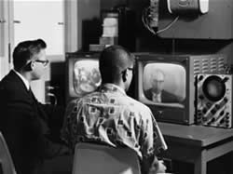
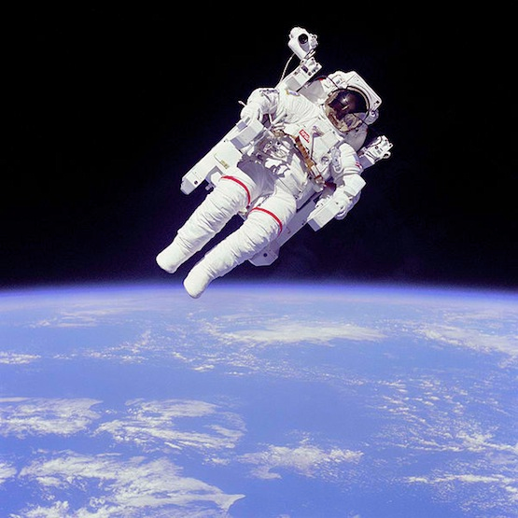
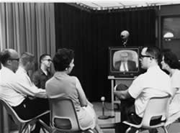
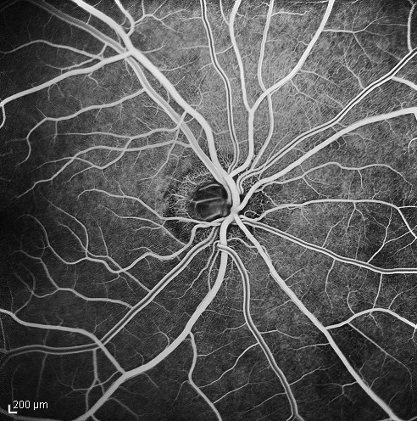

Slide 7
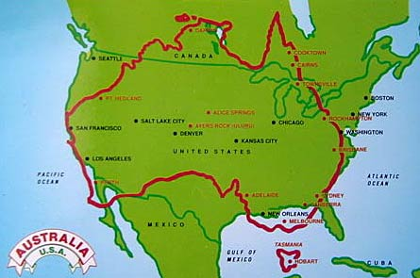
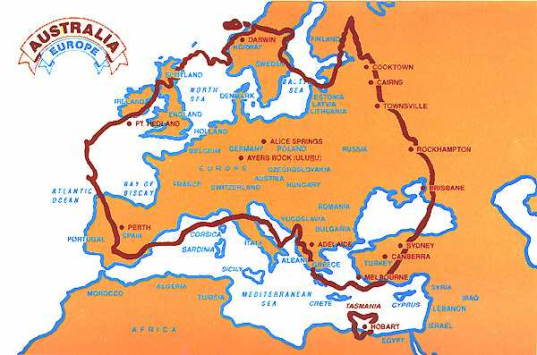

Slide 9
Method of evaluation

Slide 10
Aims of the evaluation
Who is using the service
What is the service being used for
How is the service being used

Slide 11
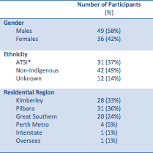
Patients using the service
Table 1. Demographic data of the participants (n=85).
*ATSI = Aboriginal or Torres Strait Islander.

Slide 12
Referring practitioners using the service
Figure 1. The cumulative number of real-time teleophthalmology consultations by referring health practitioner. ‘GP – PP’ is a general practitioner in a private practice. ‘GP – AMS’ is a general practitioner in an Aboriginal Medical Service.

Slide 13
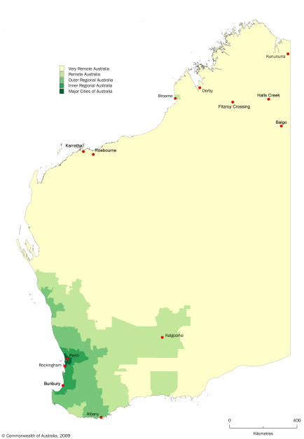


GP – AMS
GP - PP
Optometrist
Hospital DMO

Slide 14
Hospital DMO
Optometrist
GP – AMS
GP - PP

Slide 15
Aims of the evaluation
Who’s using the service
What is the service being used for
How is the service being used

Slide 16
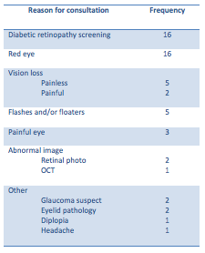
Reasons for
consultation
Table 2. The reasons for real-time tele-ophthalmology consultations when the diagnosis was not known prior to the consultation (n=56).
56 diagnosis & management
32 management for known diagnosis
12 follow-up

Slide 17
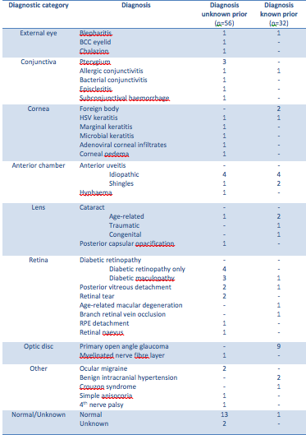
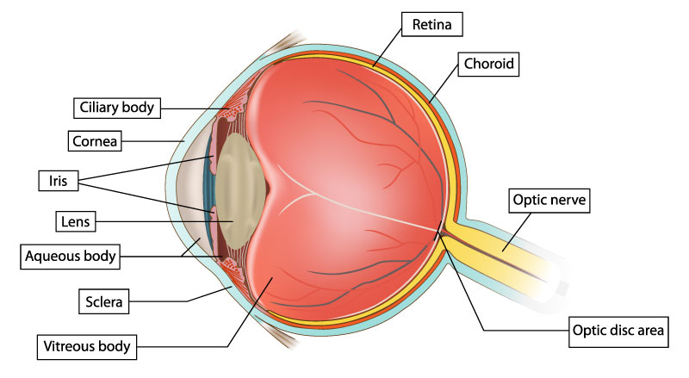
Table 3. The working diagnoses managed by real-time teleophthalmology consultations (n=88).
32 diagnoses managed

Slide 18
Management plan
Figure 2. The different management plans provided in the initial video-consultations (n=88).

Slide 19
Follow-up plan
Figure 3. The number of consultations in which health practitioners were recommended in the follow-up plan (n=100). GP = general practitioner, AHW = Aboriginal Health Worker, Hospital DMO = hospital district medical officer.

Slide 20
Aims of the evaluation
Who is using the service
What is the service is being used for
How is the service is being used

Slide 21

Means of booking the consultation
Table 4. The means of organizing a video-consultation by referring health practitioner. Percentages are the proportion of unscheduled/scheduled consultations for each specialist.

Slide 22


Video-conferencing software used
versus

Slide 23
Images provided
Figure 4. The number of consultations in which peripheral imaging equipment was used (n=63).
OCT = optical coherence tomography. Note that some consultations had multiple images from different types of peripheral imaging equipment thus in this figure n>63.

Slide 24
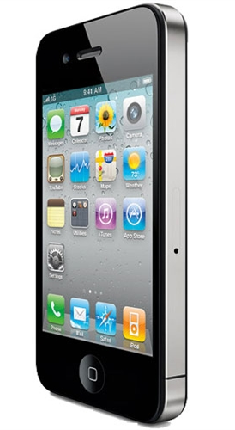
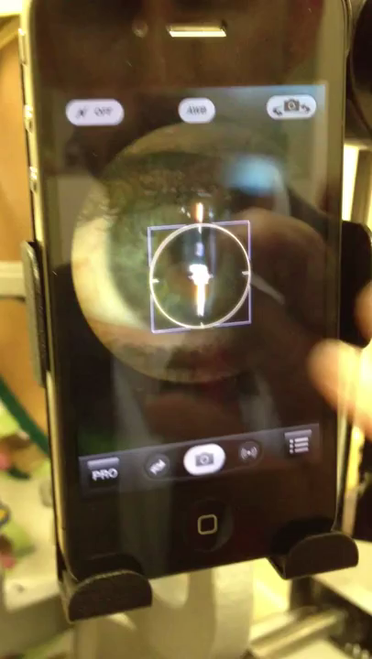
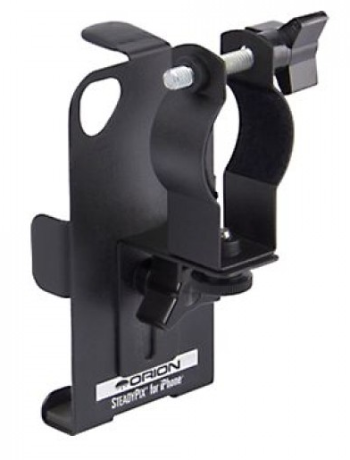
+

Slide 25
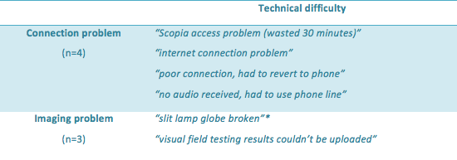
Technical difficulties
Table 5. The reported technical difficulties for real-time consultations (n=7).

Slide 26
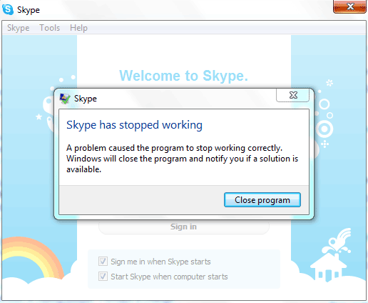
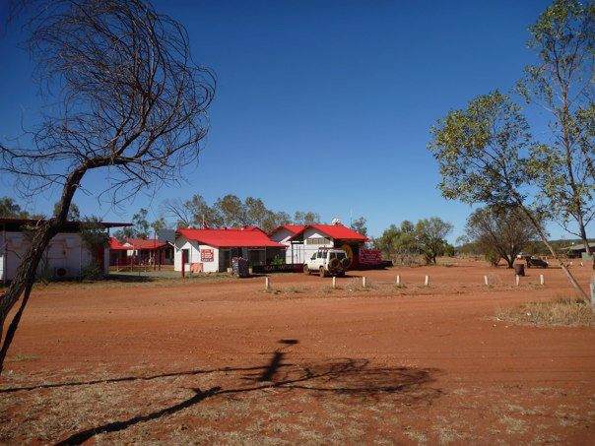



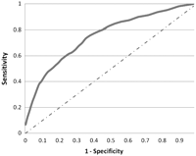

The barriers…

Slide 27
Conclusion

Slide 28

Acknowledgements
Assoc/Prof Angus Turner, Joos Meyer, Seyhan Yazar, Dr Maria Franchina, Dr Alex Hewitt, Prof Mackey
Alvina King Scholarship

Slide 29
Any Questions?

