Slide 1
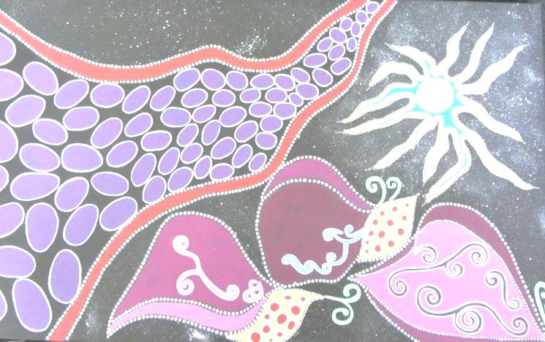

It takes a whole community to make a difference!
Every body is precious
Partnerships for Suicide Prevention in Wheatbelt Aboriginal Communities
October 2012 Perth Western Australia
Balam Balam (Metamorphosis) Painting by Iris Winmar of Kondinin

Slide 2
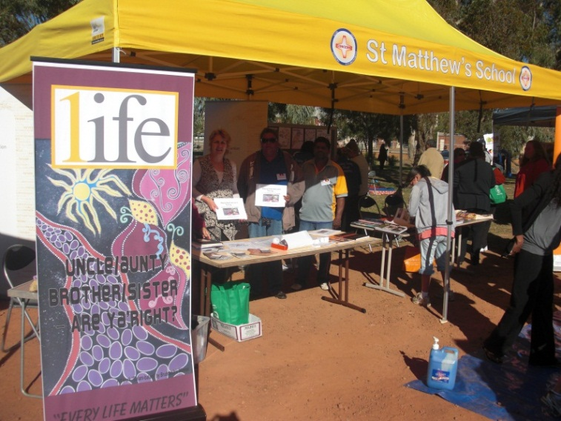
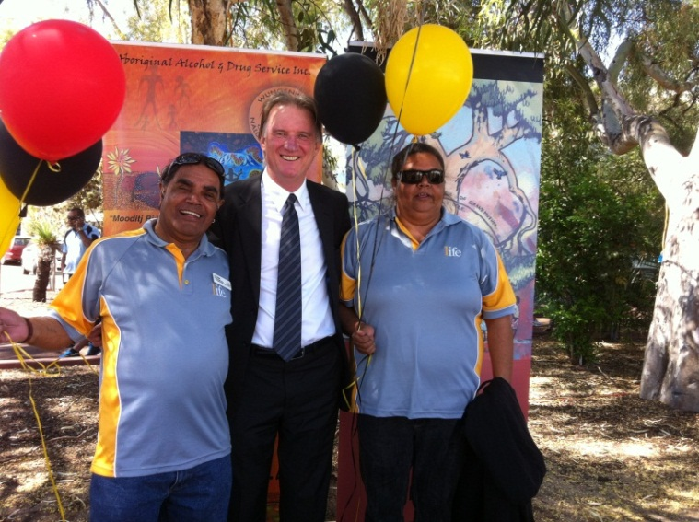
OneLife Suicide Prevention Strategy
Promoting Suicide Awareness at Narrogin Reconciliation Day – Jane Mouritz, Marcell Riley and Doug Kickett
Community Coordinators Garry Ryder and Marcell Riley with Eddie Bartnik at Yorgum Building Stronger Families Day
Initiative of State Government of Western Australia through the Minister for Mental Health, the Mental Health Commission, advised by the Ministerial Council for Suicide Prevention, and administered by Centre Care Inc
Wheatbelt Aboriginal is one of 6 wheatbelt-based OneLife programmes
They aim to all work together…..to build resilience!
Commenced October 2012
Now into Community Action Plan (CAP)- Stage 2 for next 12 months

Slide 3
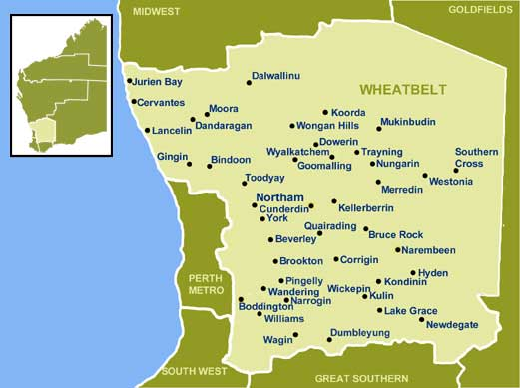
Where We Work – a big community!
Wheatbelt comprises 100 towns, 30 local governments and sparsely spread population
OneLife Aboriginal works in communities who have indicated need and local interest in community resilience-building and suicide prevention initiatives
Towns so far include Gnowangerup, Tambellup, Katanning, Narrogin, Wagin, Pingelly, Quairading, Northam, Kellerberrin, Trayning, Merredin, Bruce Rock, Kondinin

Slide 4
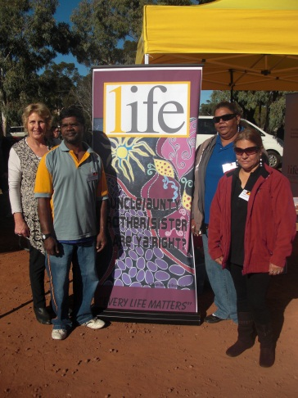
How OneLife Wheatbelt Aboriginal Works
1 x Host Agency – Dallard Pty Ltd – David Falconer
1 x Wheatbelt Network Coordinator – Jane Mouritz
2 x Community Coordinators x 2.5fte – Marcell Riley , Garry Ryder
8 x Community Support Workers - up to 16 hours/week
CSWs are currently based in;
Tambellup Nigel Penny
Katanning Andy Woods (with CC Garry Ryder)
Wagin Bert Williams
Narrogin Doug Kickett, Diana Cipriani (with CC Marcell Riley)
Quairading Maxwell Williams
Kellerberrin Jacinta Walsh, April Walsh
Merredin Erica Garlett

Slide 5
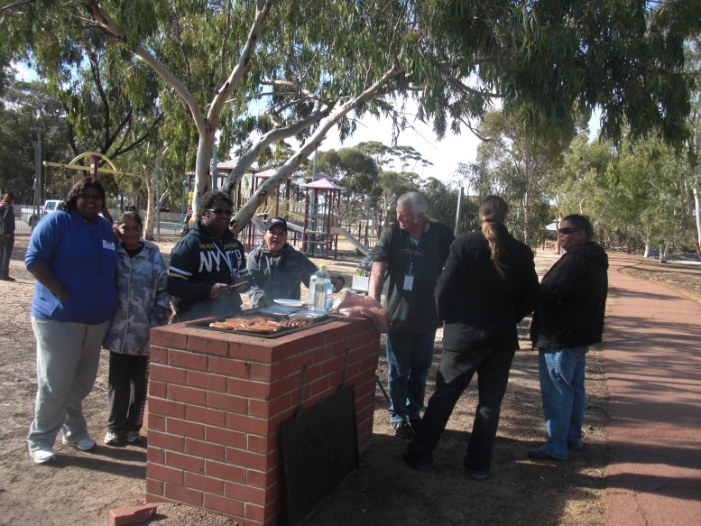
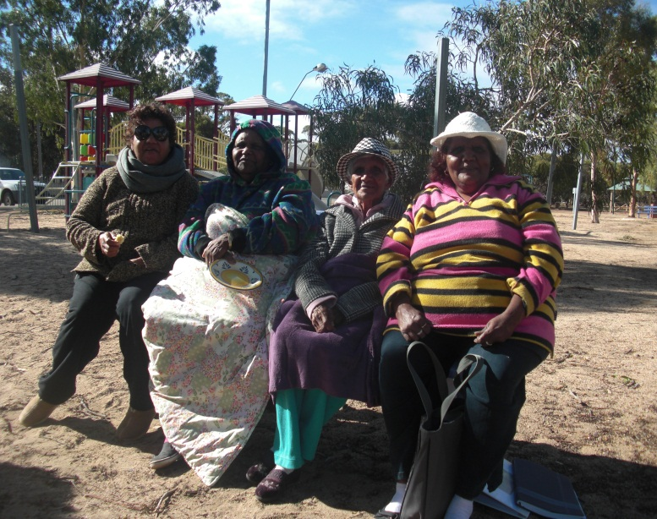
Partnerships and NO WRONG DOORS!
OneLife WAB works with as many agencies and services providers, as are willing, in the Wheatbelt;
Wheatbelt and Great Southern Mental Health Services, Wheatbelt Aboriginal Health Service, Wheatbelt Public Health Unit, WACHS, Avon Youth, Clontarf, DIA, Keedac, Police, Schools, local government, Holyoak, Rural Community Support Service, CANWA, Regional Home Care Services, PHAMS, RDAs, Sister Kate’s Homeys, Community First, Max Employment, Noongar Sports Association, MIFWA, Share and Care, Aboriginal Alcohol and Drug Services, Agcare, Palmerston, Ngala, Relationships Australia, IPCCWA, Regional Mens Health, professional consultants, many more…

Slide 6
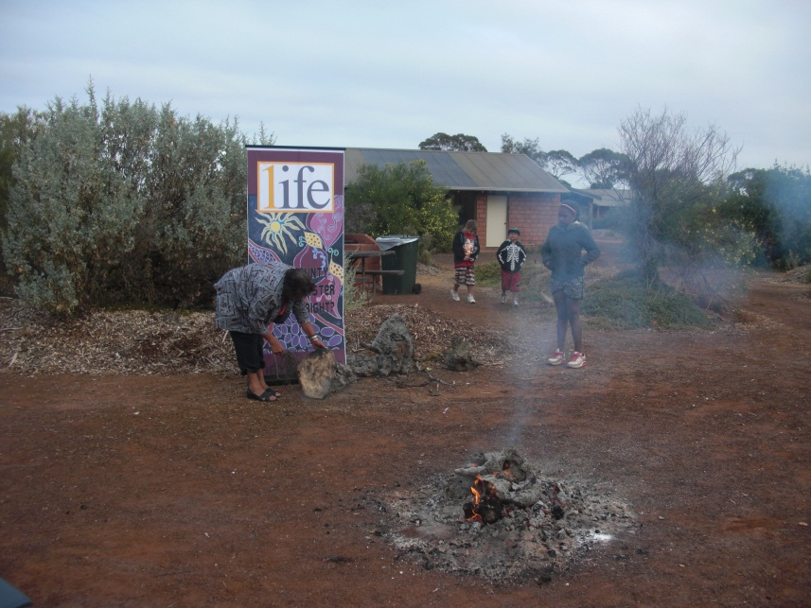
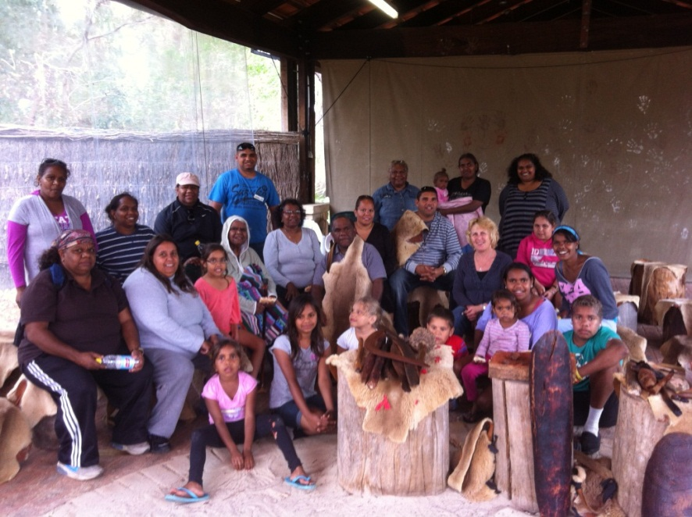
Connecting to Culture
An Aunty cooks damper in the ashes at Wave Rock Yorga Camp for Kondinin, Brookton, Bruce Rock and Narrogin
Quairading community at Yanchep National Park Cultural Centre – everyone loved the didg!
To move forward for the future, Noongar people need to reconnect with their past, heal the hurt, re-learn the stories, re-gain pride and strength –
OneLife CAP 1 consultation outcome

Slide 7
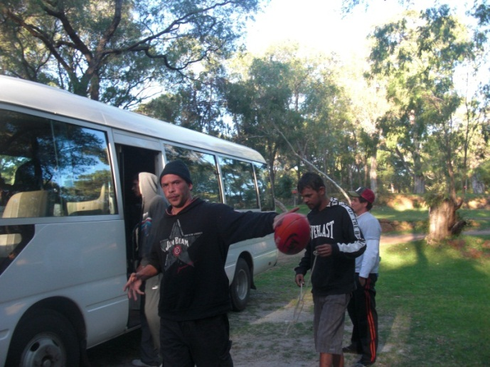
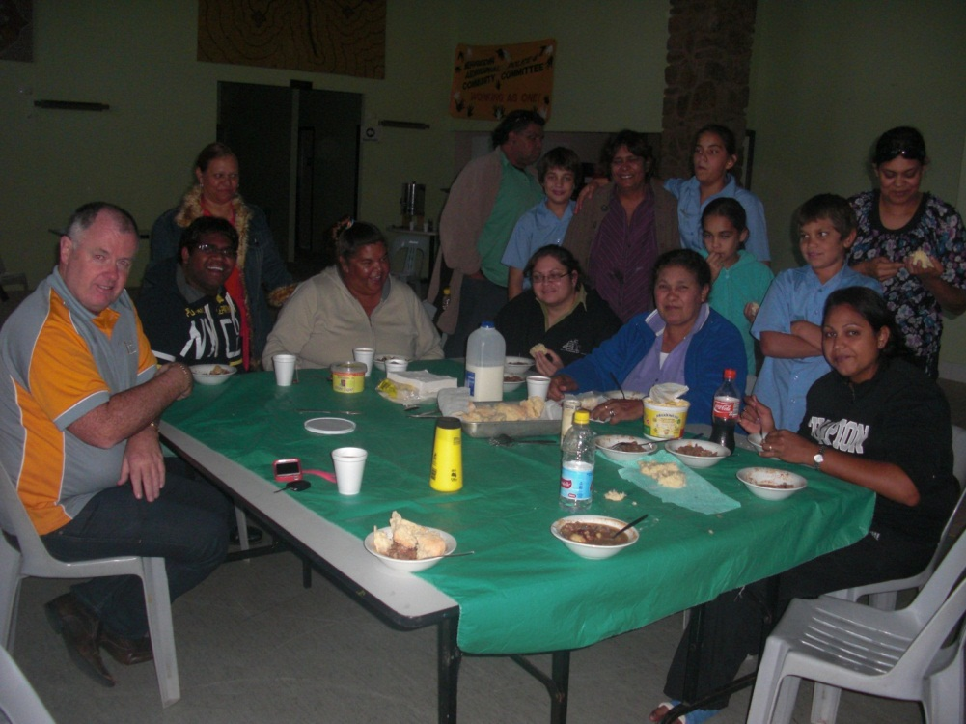
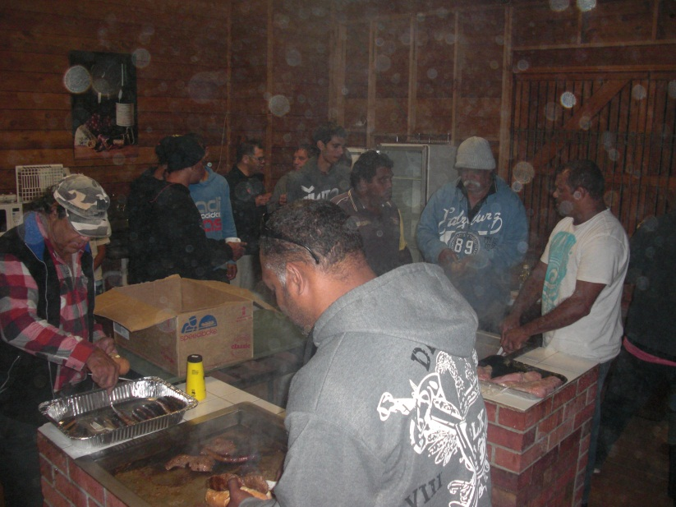
Building Resilience through social recreational and educational opportunities
Glenn Mitchell shares kangaroo stew with Merredin community after speaking to them about his mental illness and suicide risk. They all shared in the Staying Solid with SAFE Yarning Session too.
Wagin men and boys at Bremer Bay Camp – they fished, yarned and shared in the Staying Solid with SAFE Yarning session too

Slide 8
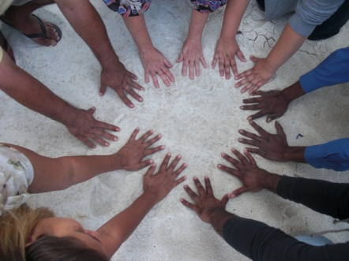

Suicide Awareness Session for Noongar People
Staying Solid with SAFE Yarning – designed by Aboriginal people for their people
Acknowledgement and sincere appreciation to Jodie Davis, Linda Sharman, Elaine Ryder and Leanne Moody and WAHS in Northam, Western Australia
Suicide Awareness For Everyone – culturally appropriate
Brother, Sister it is ok to talk…. Simple but effective
Many Elders were consulted and their approval gained
Endorsed by the Ministerial Council for Suicide Prevention for WA
Being evaluated by ECU Sellenger
Centre Researchers

Slide 9
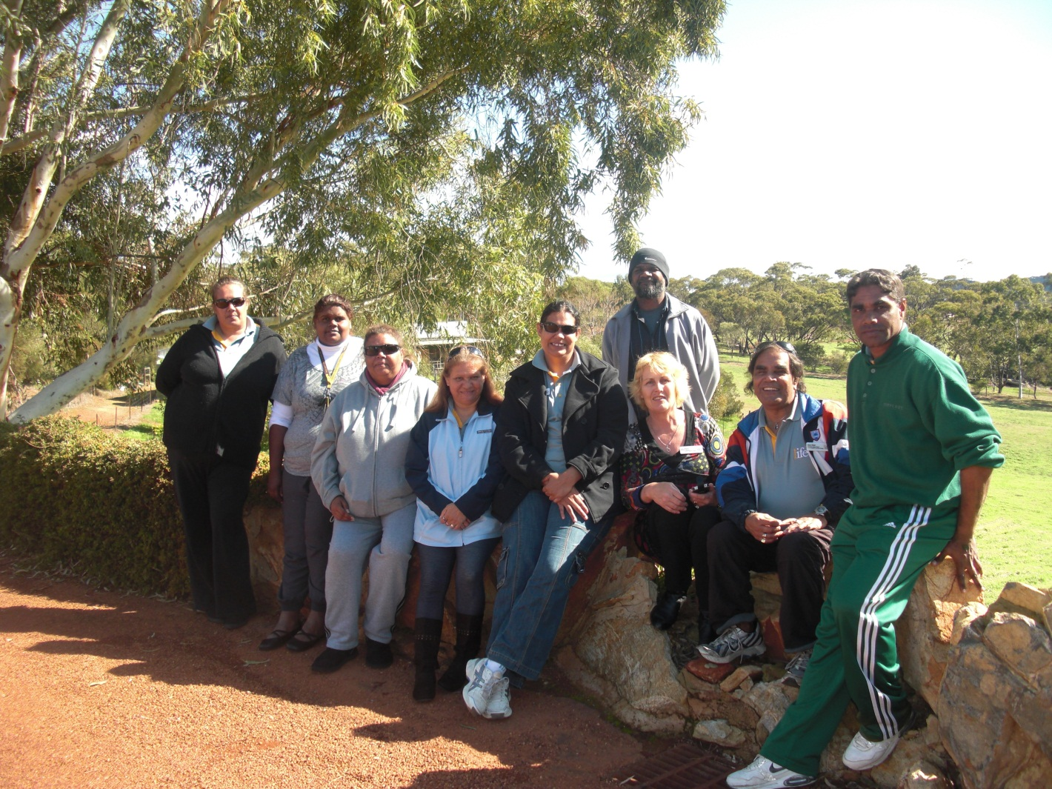
WAB will make a difference….
Wheatbelt Community Support Workers building a strong team so they can support each other, their families and their communities to raise suicide awareness and grow resilience.
It takes a whole community to reduce the risk of suicide.

